Slide 1
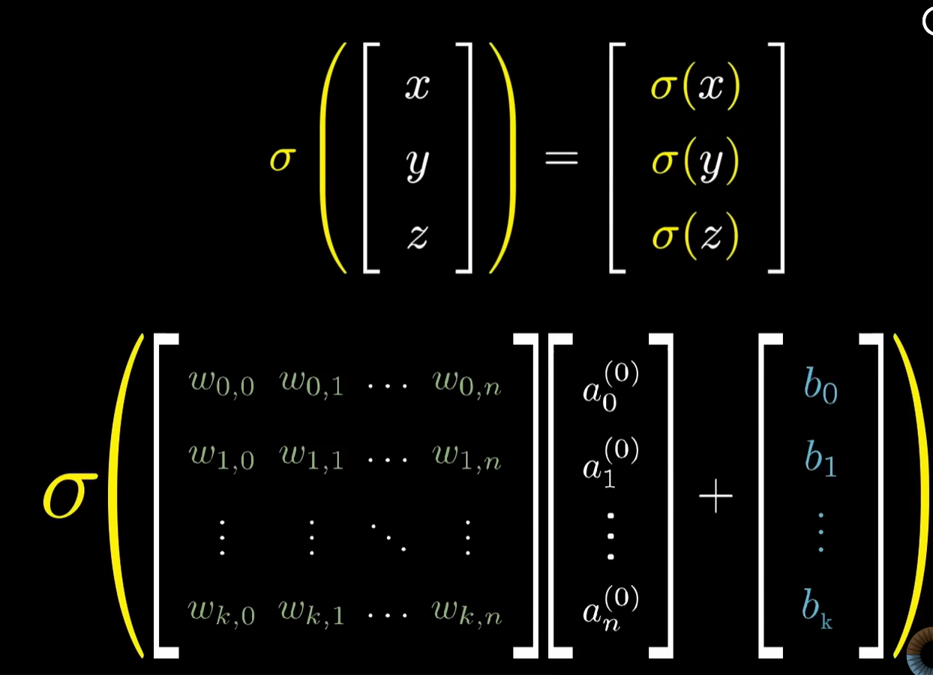
Easy to think of things like a pixel and a grayscale value, which is why if we have higher numbers or 1’s we can think of it as white, but in reality think of it like neurons and activation numbers. Which is why when we are trying to match it to something later on, it is like okay, if we have a block of the image there that is white in a certain part, if I am doing my activation numbers times the 784 weights that correspond to that one image, it is like the higher it is, the more likely we got white there, or the more likely we do not have white there depending on the weights in this case.
I would say it gets more complex when we start caring about brightness as well instead of just okay is it there or not and how much of it, like if we are trying to match a curve or something because then the higher the number does not automatically mean better if that makes sense. It only makes sense if pure white is what we want for that edge.
I wrote it as [activation numbers] * [[weight set], [weight set]], but basically same thing, and yeah, I already had the conclusion that biases are also a vector, and this allows us to customize each bias too.
But it looks like learning means instead of us humans going in and manually typing out each weight set and bias, learning means the computer starts to understand what numbers to make inside the weight sets given the amount of weight sets.
Weight sets have the same amount of numbers in them as the amount of neurons, otherwise you literally cannot multiply. And yes, these weight sets, like I thought, are where we can be smart about it, like keeping negative weight numbers where there are edges because otherwise it is just a giant white blob, and positive where we want it to be white gives us the result we want.
And understanding this, if I want 16 new activation numbers, I need 16 weight sets that are each the size of however many neurons I had before. And each of these weight sets will do a job. Like in an image example, if that number after being converted through sigmoid is close to 1, that means we most likely have that edge in our image.
If we cannot recognize a certain kind of edge, we probably know to add another weight set. Or if we see it keeps pinging a certain kind of edge as something else, we know to go into the weight set for that edge and edit it, or edit the bias for that edge.
One thing none of this accounts for is location. Like yeah okay, location matters, but what about smaller 7’s and bigger 7’s at different points in the image in the same system? I do not really know yet.

Slide 2
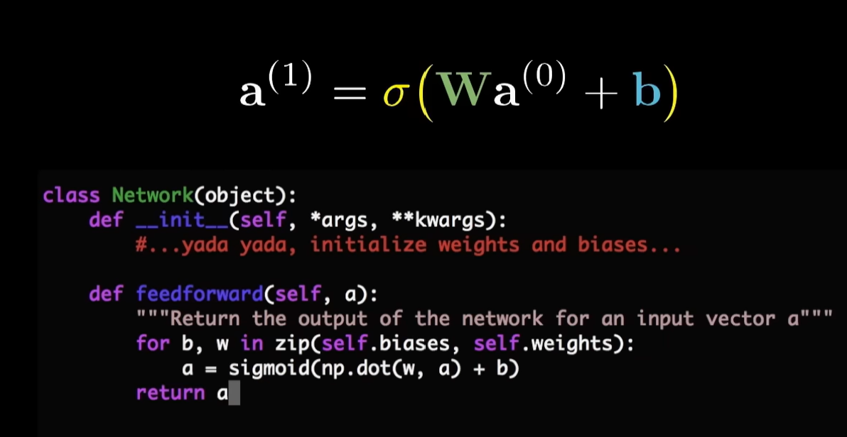
After one layer
Like we can go into it with an idea of what we want each layer to kind of do. For example, we are able to control how many weight sets there are in a layer, which also controls how many activation numbers come out after that layer.
So maybe we think:
okay, let this layer have 16 activation numbers to hopefully classify simple edges,
then another 16 activation numbers to maybe classify more complex features,
then finally 10 activation numbers at the end representing the digits 0–9.
But the thing is, we do not actually know if the network is going to solve the problem in the exact way we imagined.
The only layer we can really assign a direct meaning to is the final layer, because our training data is labeled there. Like we know what those final 10 outputs are supposed to represent. And obviously we know what the input layer is too since that is just the image or the raw data we feed in.
But all the layers in between, we do not truly know what exact function each neuron or layer is going to end up doing. We can hope a layer starts learning edges or curves or features, but deep learning and backpropagation basically let the network figure out its own internal strategy for solving the problem.
So even if we design the structure with intentions in mind, we genuinely do not fully know how the network is internally going about the problem once training starts and backprop keeps adjusting the weights.

Slide 3
Wait, yeah—now to learning. How do we manually not put in what each weight has to be and what each bias has to be? How does the machine just learn that? Does it even know at one point how many sets of weights there have to be to best achieve our goal of recognizing a number?
No. We define the number of layers, neurons, and therefore the number of weights and biases. The only thing learning and backpropagation do is adjust those weights and biases so the network's output better matches what the input is actually supposed to be classified as.

Slide 4
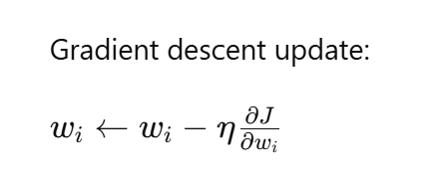
See it is proportional. If that partial is increasing, then you want to go opposite direction with the weight, so it becomes -.

Slide 5
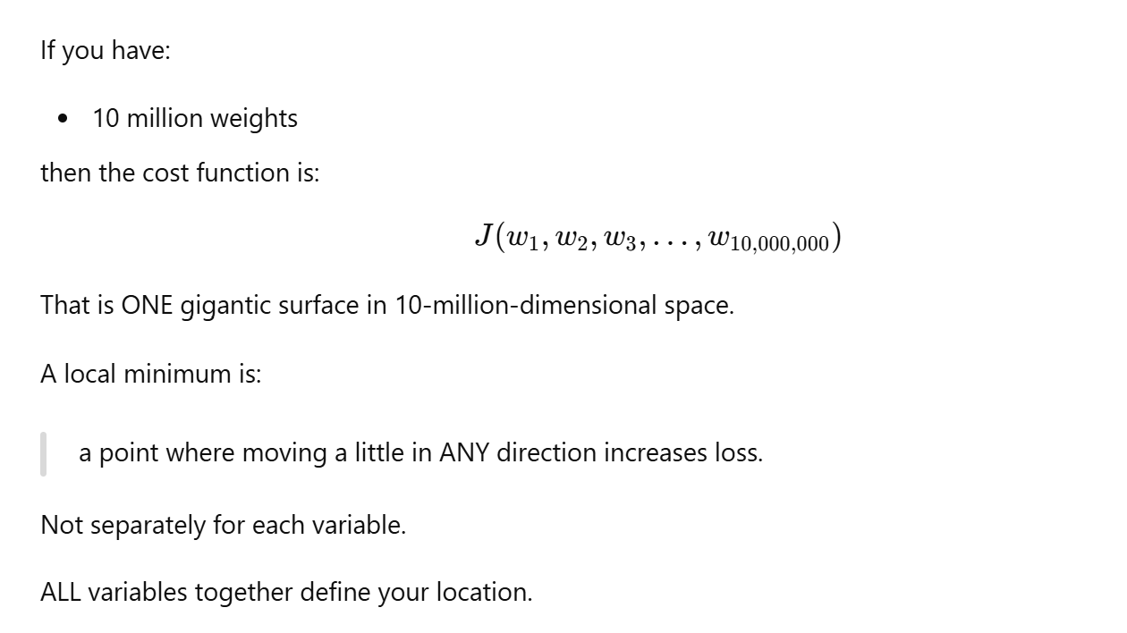
The idea that moving in any direction causes loss to increase is actually a really good point.
And it also connects to my intuition that even though we talk about one overall point in parameter space, we are still getting there through individual variables.
Like I am basically trying to get each partial derivative to 0.
I am going to adjust my x until the partial with respect to x is 0. I am going to adjust my y until the partial with respect to y is 0.
And whatever point satisfies all of those at once is probably going to be some local minimum.
Like say it ends up at the point (1,3) for example. I still adjusted each variable separately in order to get there, but notice how it still results in one final point overall.
So even though we think about adjusting parameters individually through their own partial derivatives, together they still define one location in the overall cost landscape, which is why it corresponds to one local minimum.

Slide 6
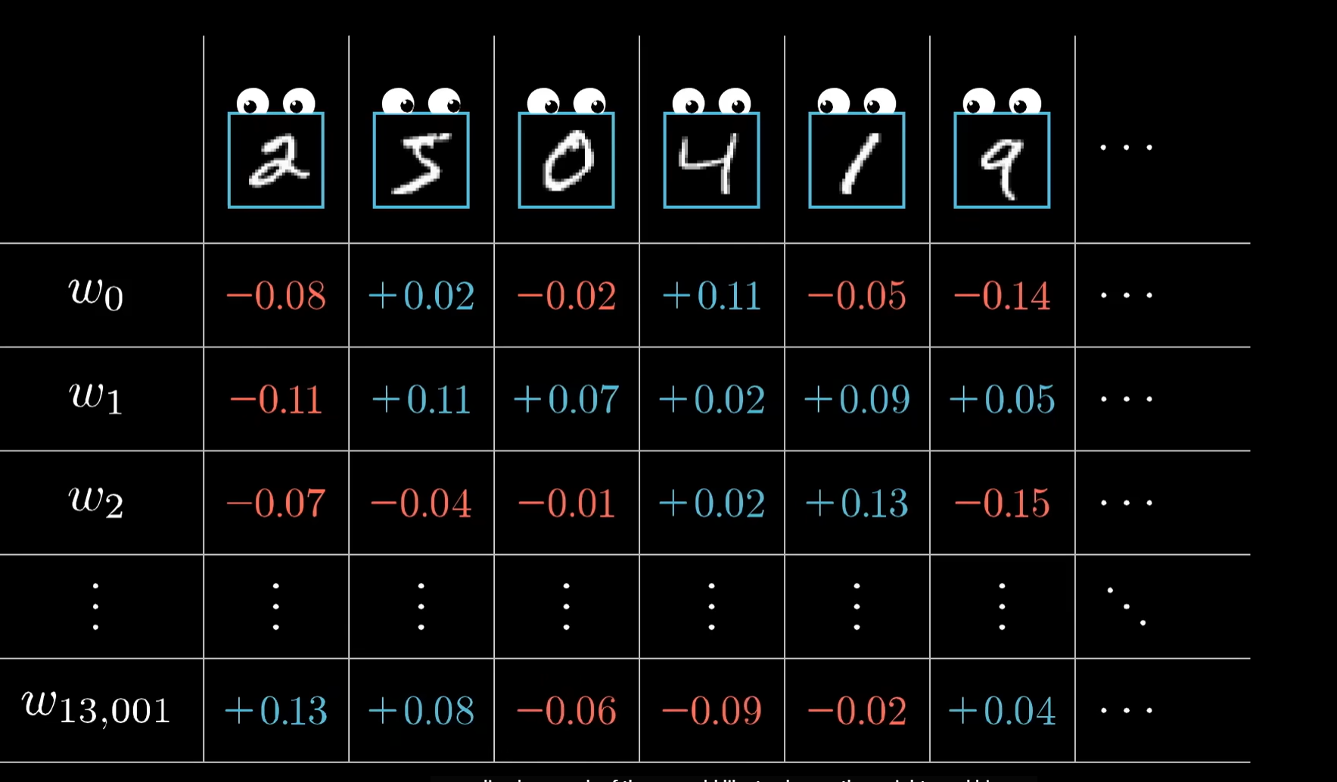
Each training example produces a suggested update for every weight and bias. Instead of updating immediately, accumulate these suggestions across the entire training dataset. After all examples have been processed, combine (sum or average) the updates and apply them to the network's weights and biases.

Slide 7
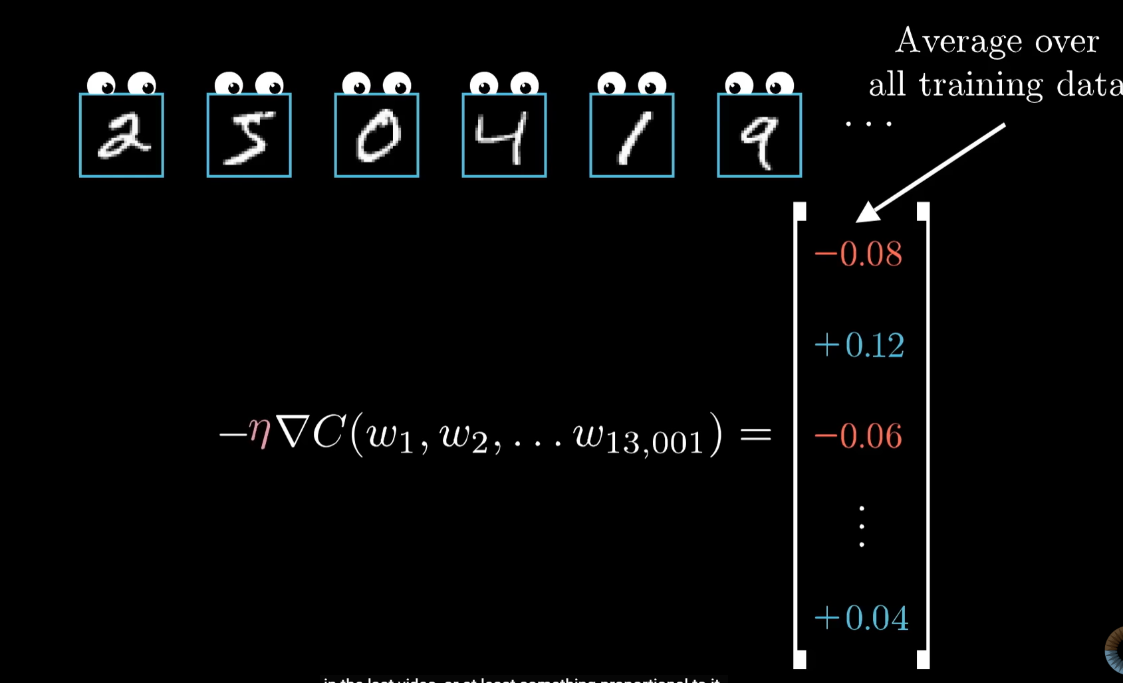
This is the whole point of backpropagation. We have one giant cost function, and backpropagation figures out exactly how every weight and bias contributes to that cost. It tells us what changes each parameter should make. After summing (or averaging) those changes across the training data, we get the overall gradient. Then we nudge every weight and bias in the opposite direction of that gradient, run the network again, and keep repeating until the cost gets smaller.

Slide 8
Final explanation of back propagation and gradient descent
Okay, so pretend we are at the final layer and taking the example of one piece of training data. We know the result needs to be something like [0,0,0,0,0,0,1,0,0] if we feed in the image of an 8. We already know what the correct output should be.
So the weight set that corresponds to that one neuron, or whatever components are contributing to making that one slot high, basically need to be beefed up. Whether that be the weights, the activation numbers coming into it, or the bias.
Now pretend I could not directly control the weights or biases. Then I would obviously want the activation numbers helping produce the correct slot to go up, right? But for all the other slots, I would want the activation numbers going into them to go down. I can basically sum up the changes that I need for each neuron in this input for this final layer.
So even with this oversimplification, I now know what kinds of changes I want in my inputs for this output to happen.
Which NOW allows me to go one step backwards. If I know what changes I want in the activation numbers going into this output layer, then I can ask:
“What changes do I want in the weights, biases, and activation numbers feeding into THOSE activations to make that happen?”
Which is where you can repeat the process.
This right here was the input for the final layer:
[up arrow, down arrow, up arrow, etc.]
So now it becomes:
“How do I get THIS?”
Now for the one with the up arrow, I know I want whatever activations in the input help produce it to go up. Then for the down arrow one, I know I want the activations in the input helping produce that one to go down for example.
Then I can sum all these desired changes up again to figure out what changes I now want for each neuron in THAT previous layer.
And you are able to repeat this process backwards layer by layer.
Backpropagation basically tells me the kinds of changes I want to make to all the weights and biases across the network across different training data.
And in loose terms, this connects to gradient descent, because these are the changes we want to make to better match the final results we already know the network is supposed to output, even if we are not directly talking about cost functions and partial derivatives yet.
Also I know the example I gave is very rough and ignores how the weights and biases actually interact with the activations, but even then it is still possible to think about what changes you want. Like if I want a neuron activation number to increase, I can still think about increasing certain weights or increasing the bias to help make that happen.
But when you actually get into the math, you can see that the impact changing a weight has on the overall cost function is heavily dependent on the activation it is attached to. Because if the activation feeding into that weight is not that strong or “bright” anyway, then no matter how much you change that weight, it is not really going to have a huge impact overall in the bigger picture.

Slide 9
What I am basically realizing is that during backpropagation, we are figuring out the adjustments we should make to each weight and bias every time we give the network data. Then when we give it a lot of different training data, all of those suggested changes kind of add together overall into a collected idea of:
“Okay, these are the changes you should make to best get closer to the actual outputs the data says you should have.”
And even though mathematically this is all tied to giant nested functions, partial derivatives, and gradients with respect to every variable, intuitively I do not think that is the best way to picture it in your head at first.
Instead, what we can think about is: we are learning how to adjust the weights every step in a way that gets us closer to the result we want.
And is that not also intuitively understanding how to reduce the cost function? Because reducing the cost function literally means getting closer to the correct answers.
Which is why backpropagation feels so connected to negative gradient descent.
Backpropagation is basically computing: “How should each weight and bias change to reduce the cost function?”
Then gradient descent is the actual step where we apply those changes and update the parameters.
So in my head, backpropagation almost feels like “finding the negative gradient,” because it is telling us the direction the weights should move to better match the actual outputs. Then the next step is actually changing the weights and running the process again.
Usually, in full gradient descent, we would sum up the changes needed across all training data before updating the weights. But in practice, a lot of the time we only use portions or batches of the data because we want to spend less time calculating before updating the weights and trying again. That is basically the idea behind stochastic or mini-batch gradient descent.
Will actuallly change the weights in the same way as suggested. Tho the one thing intuviely I don't piece together was in the rpeivosu example we would see how the weight being changed affects the change in the cost funtion so then we would change it accordingly in magnitue. But back propigation it automatically changes it to get close to the actual thing those weights all added together, I feel like each induvisual change in the back prop thing added up I don't know if that represents the partial deriviative anymore.
Understanding back prop is a really good way to see why diverse data matters. Otherwise the network just learns how to make everything a two for example, regarless of the input you put in. Its also why the layers do randomly end up doing something rather than just like assuming edges -> features -> numbers.

Slide 10
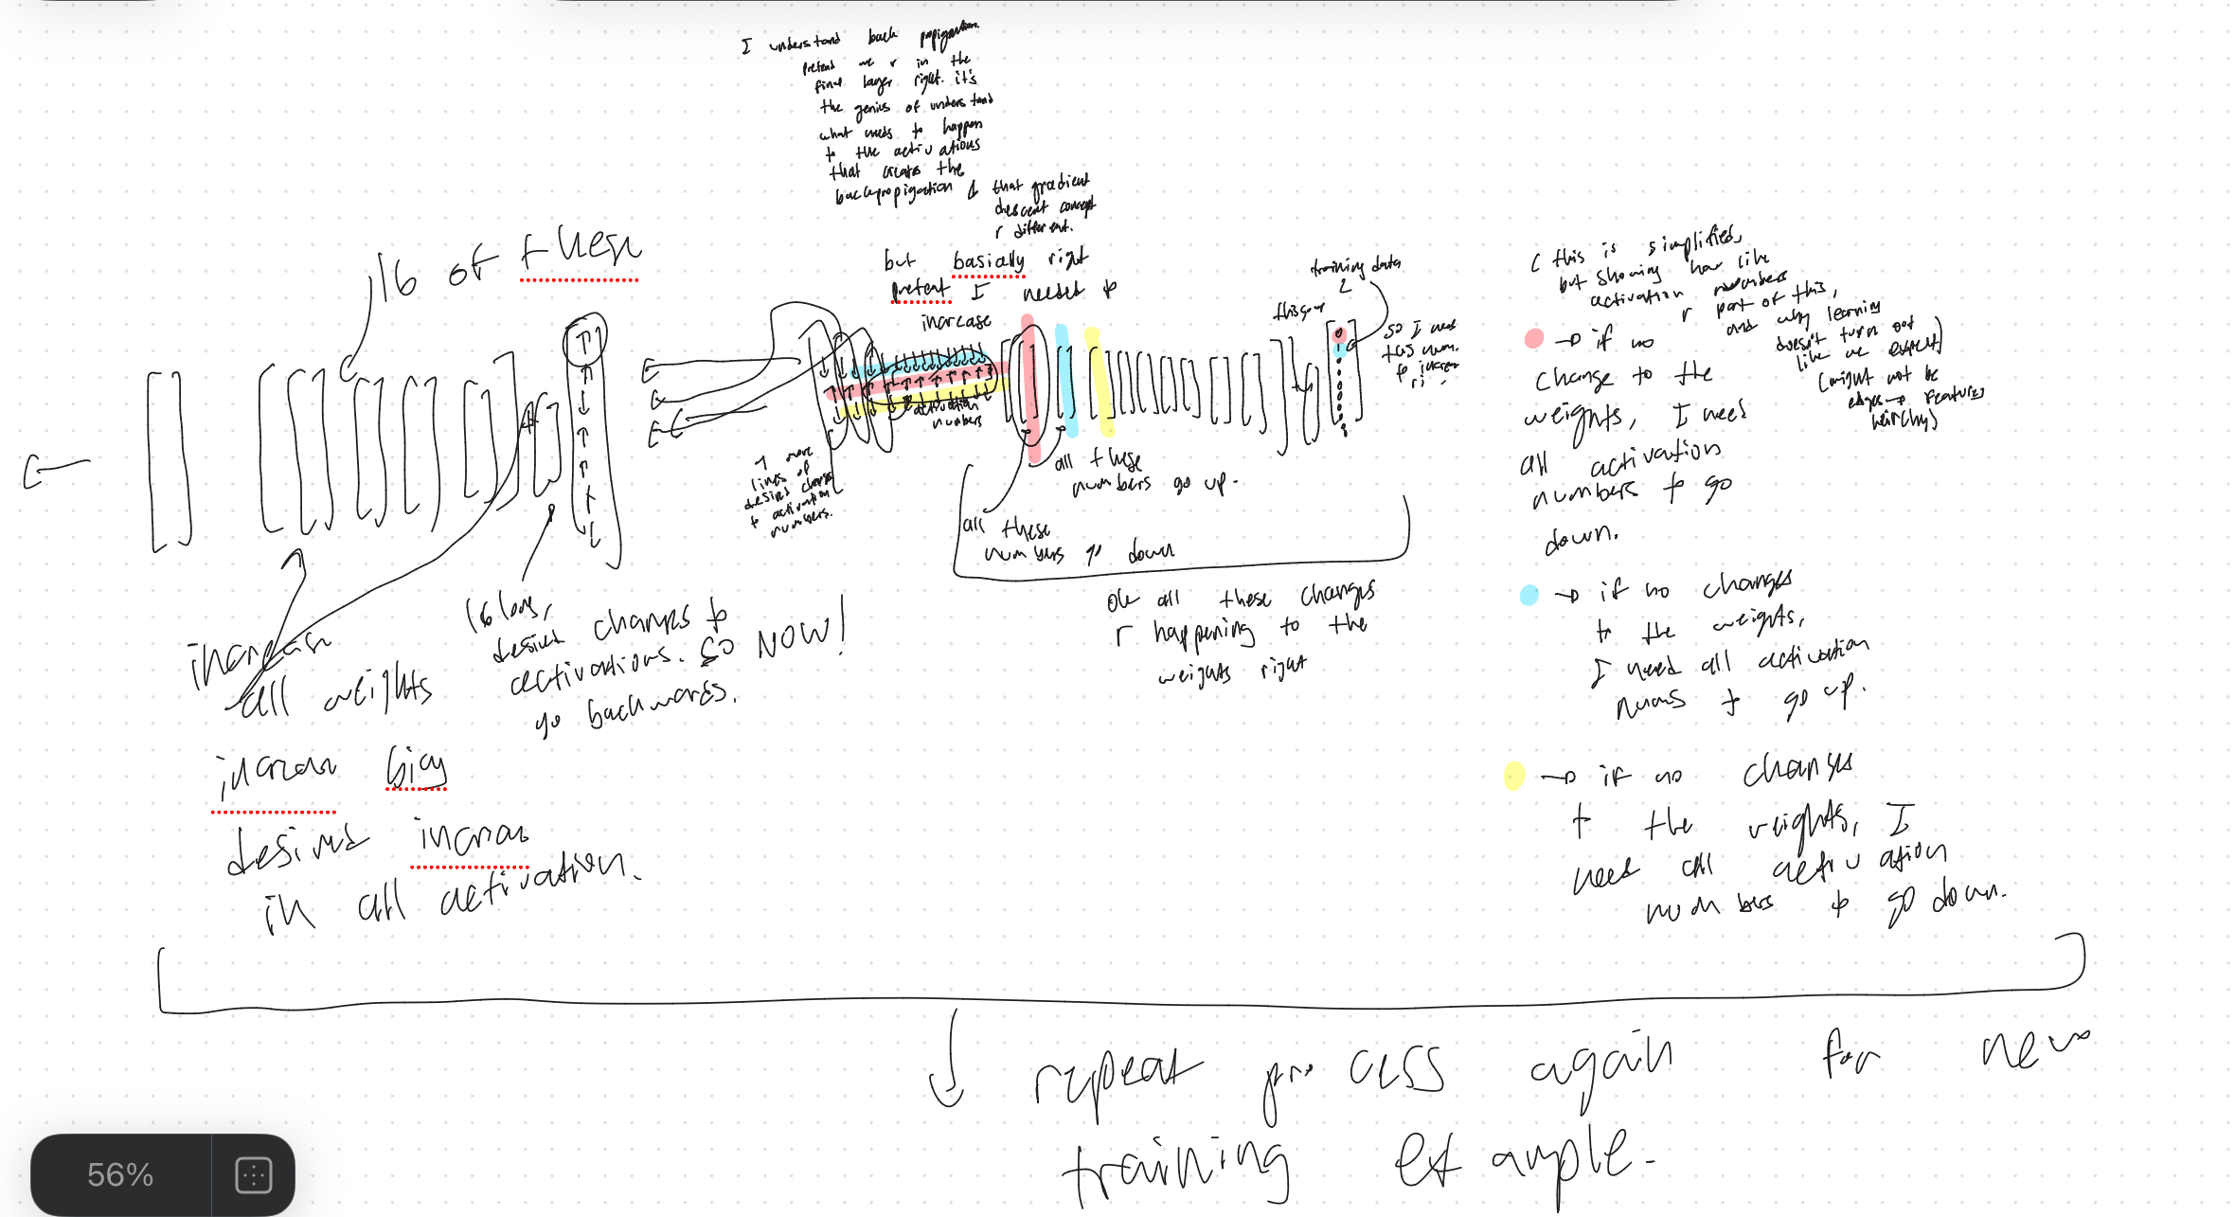

Slide 11
The impact of the weight changing is actually dependent on the strength of the activation it is attached to which is so cool and the math shows that, including the math notation.

